Slide 1
3D Computer Vision
Dr. Hassan Foroosh
School of EECS
UCF

Slide 2
Self-Calibration for Rotating and Zooming Cameras
Pan-Tilt-Zoom (PTZ) Cameras

Slide 3
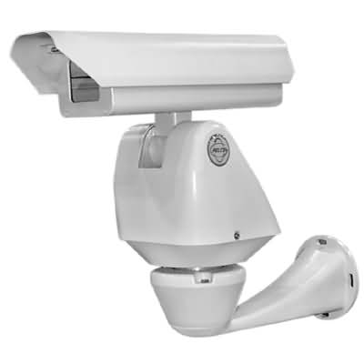
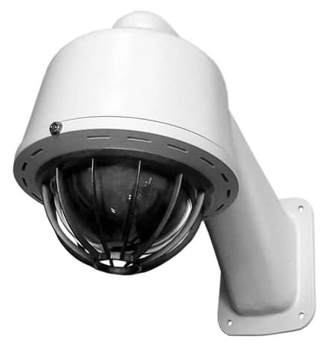
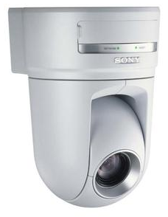
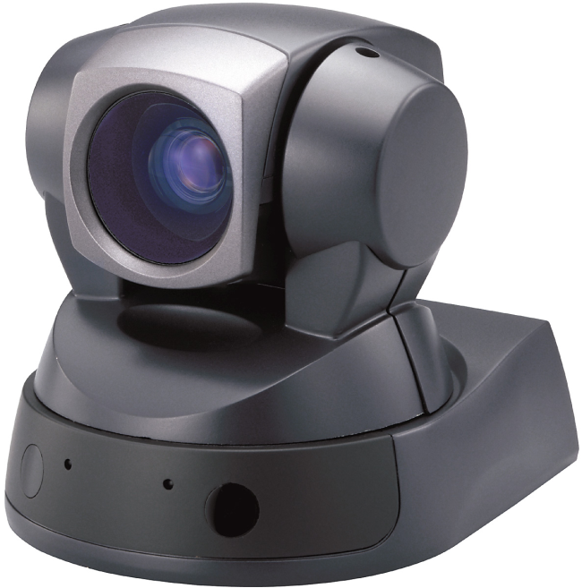

Slide 4
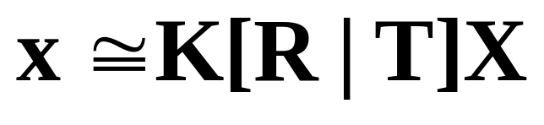
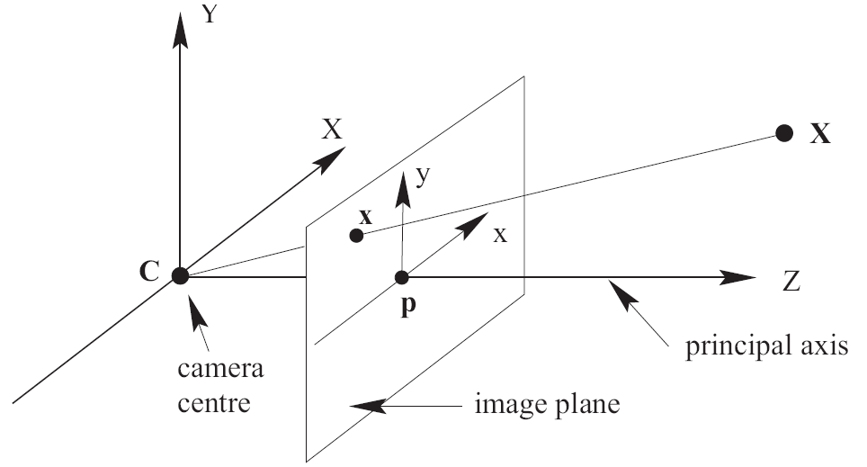
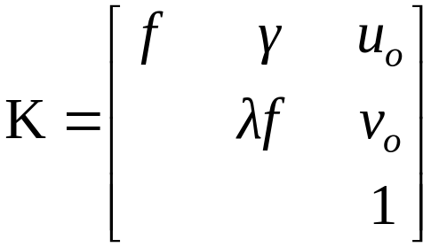
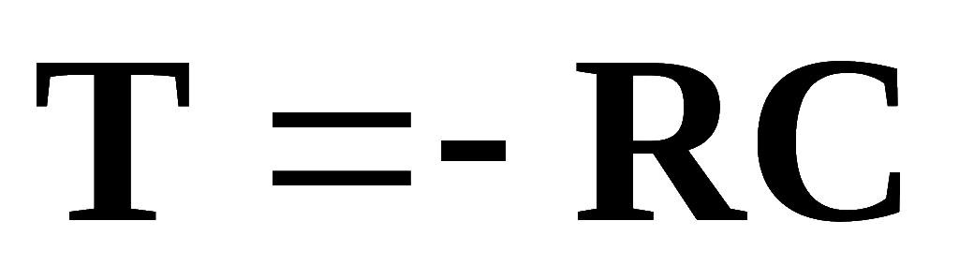
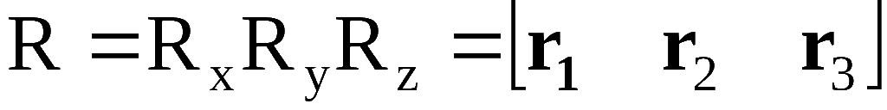
Background -Pinhole Camera Model
Translation Relative to the world origin
Rotation relative to the world origin

Slide 5
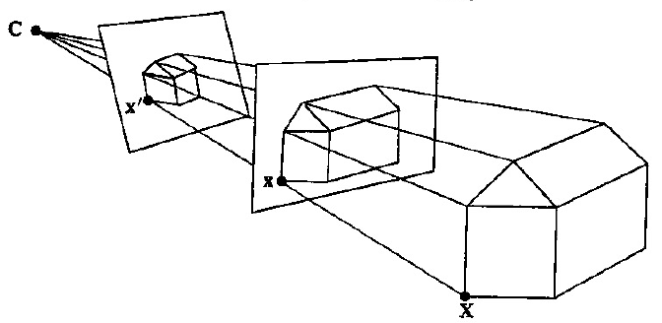
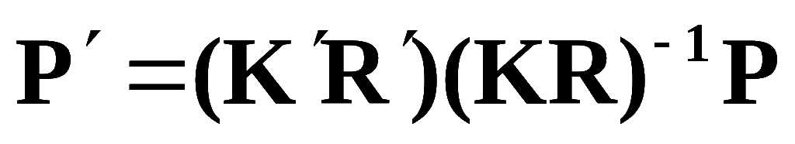
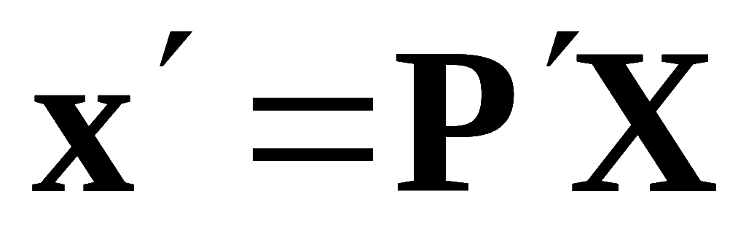
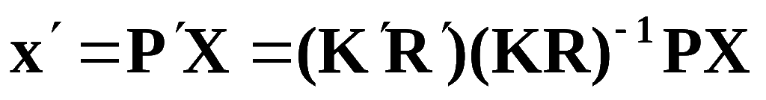
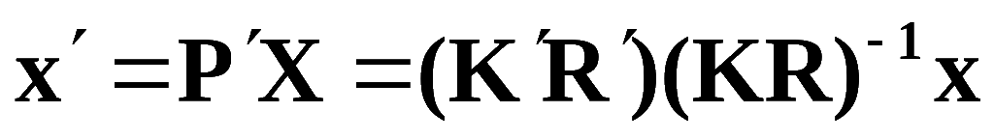

Fixed Camera Center
Object in 3-space and the camera center define a cone of rays.
Images are related by:

Slide 6
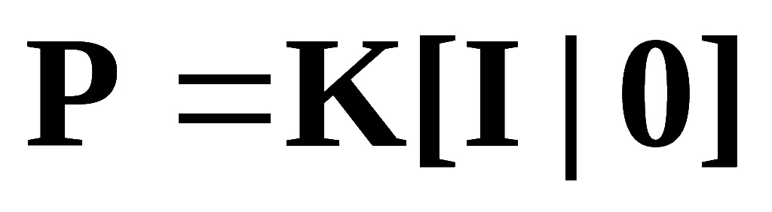
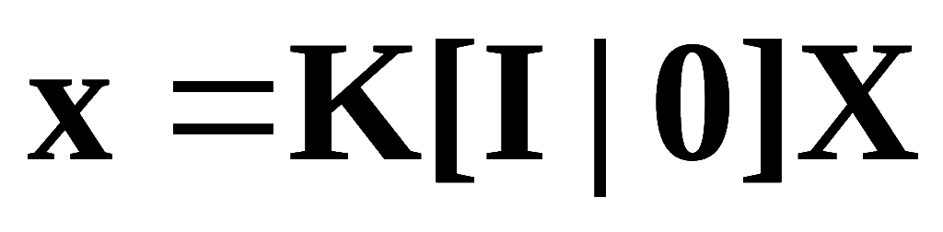
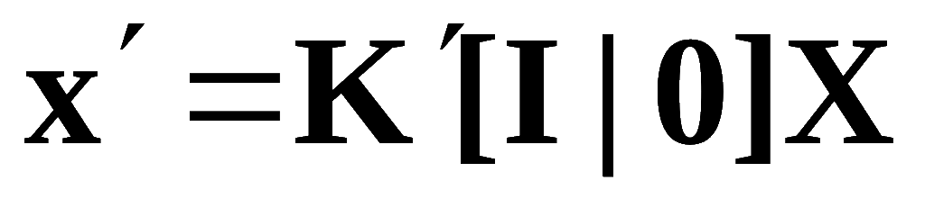
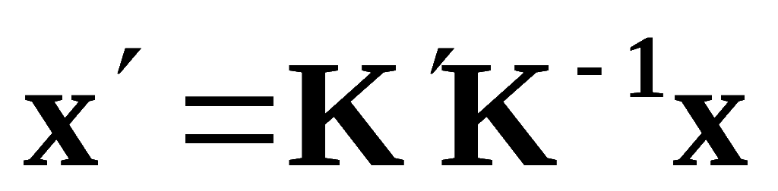
Fixed Camera Center
Moving the Image Plane:
For simplicity:

Slide 7
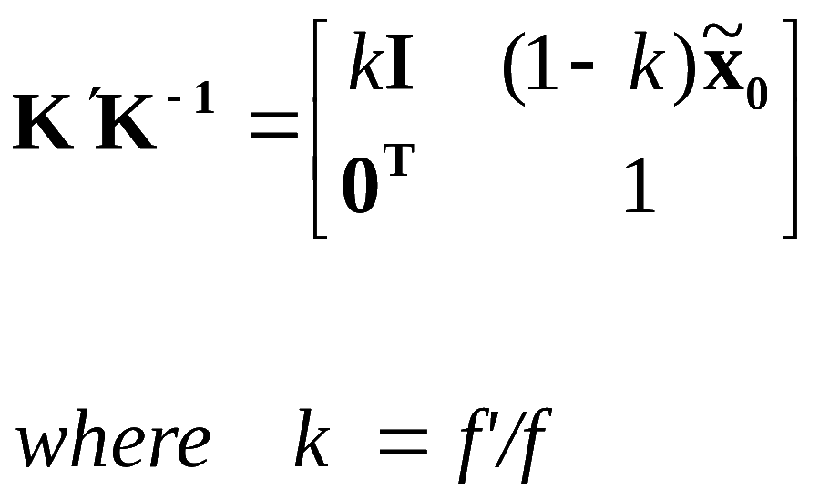
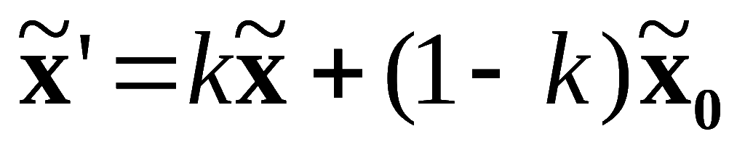
Fixed Camera Center
Moving the Image Plane:
If change is only in the focal length:

Slide 8
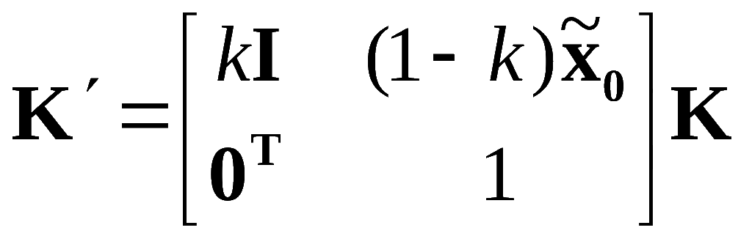
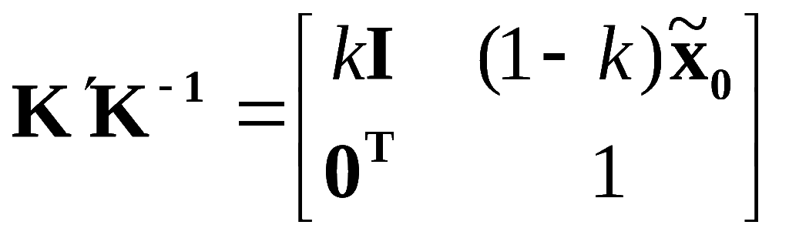
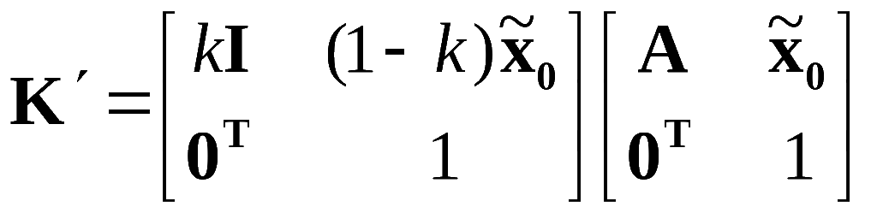
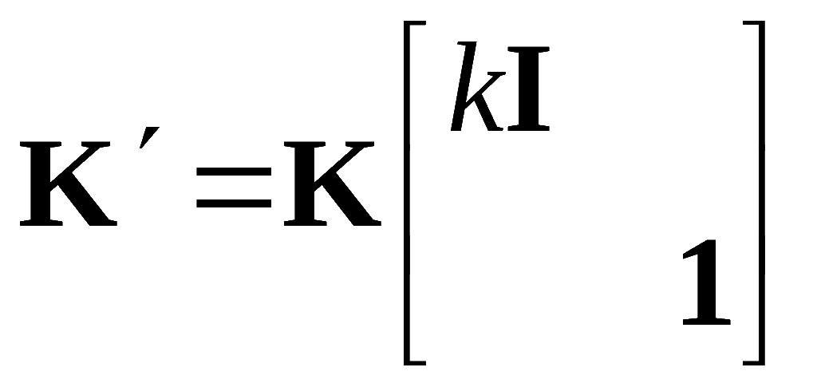
Fixed Camera Center
Moving the Image Plane:
For a general K:
The effect of zooming by a factor k is to multiply the calibration K on the right by diag(k,k,1).

Slide 9
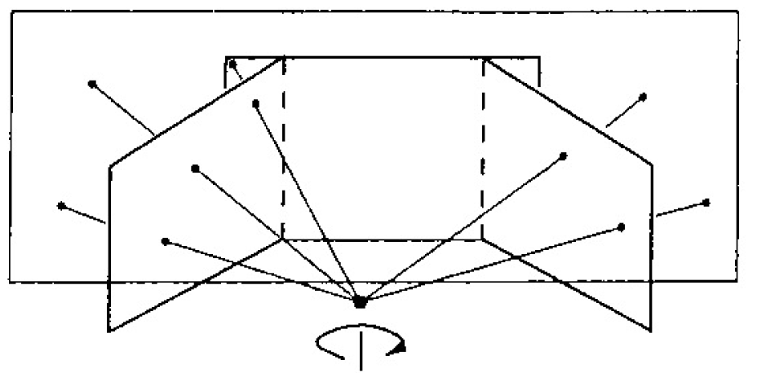
Fixed Camera Center
Camera Rotation:

Slide 10
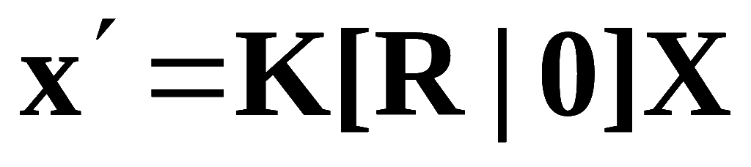
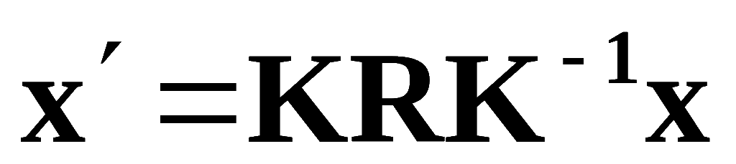
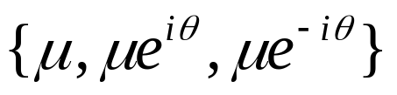
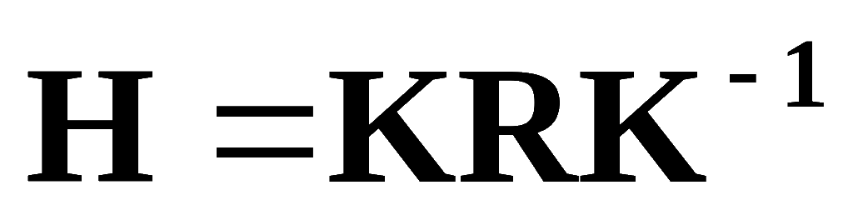

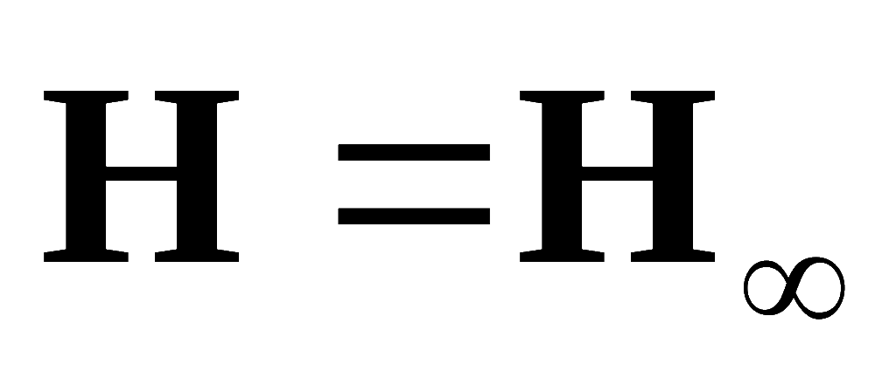
Fixed Camera Center
Camera Rotation:
For simplicity:
Same eigen values as the rotation matrix
Angle of rotation:
Vanishing Point of the rotation axis
Conjugate rotation

Slide 11
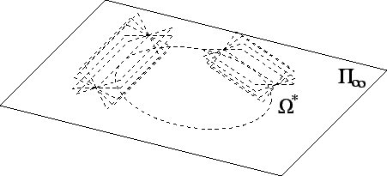

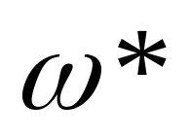
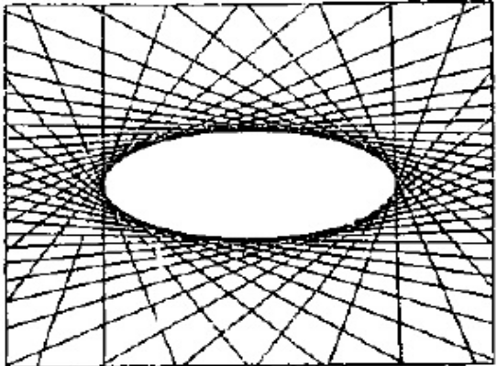

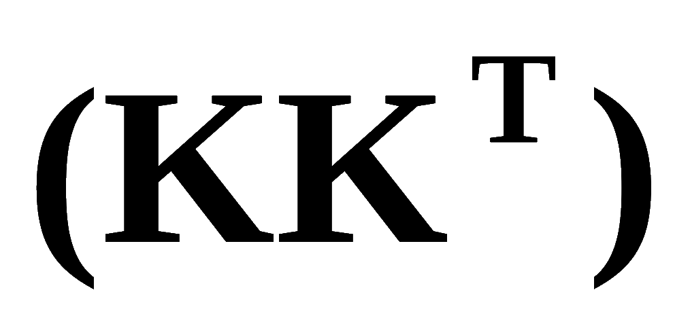
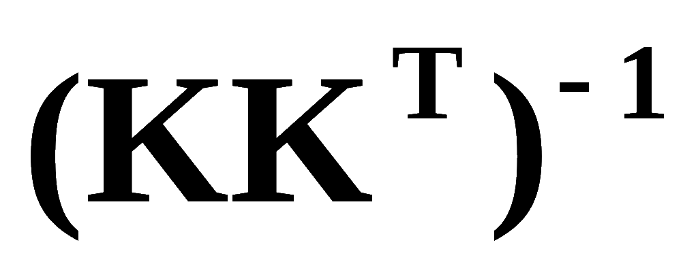
Clarification
DIAC
IAC
AQ
DIAC
AC
IAC

Slide 12
Self-Calibration of Stationary Cameras
Richard I. Hartley
International Journal of Computer Vision(IJCV)
Volume 22 , Issue 1
Pages: 5 - 23
Year of Publication: 1997

Slide 13
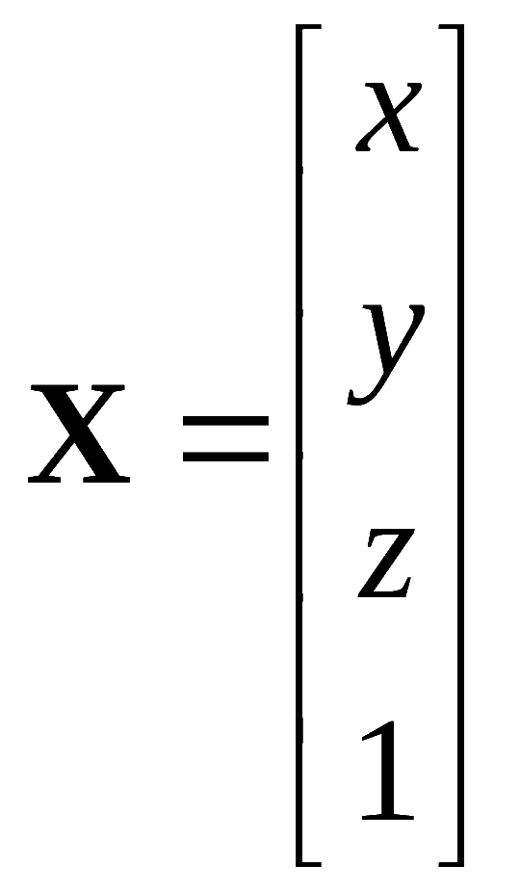

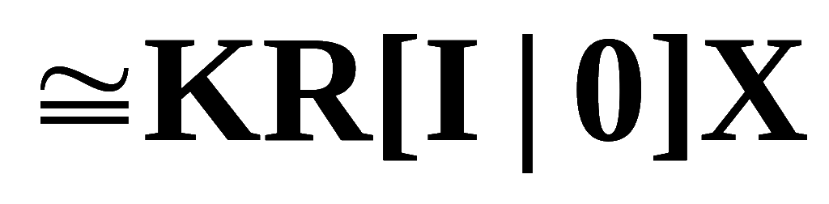
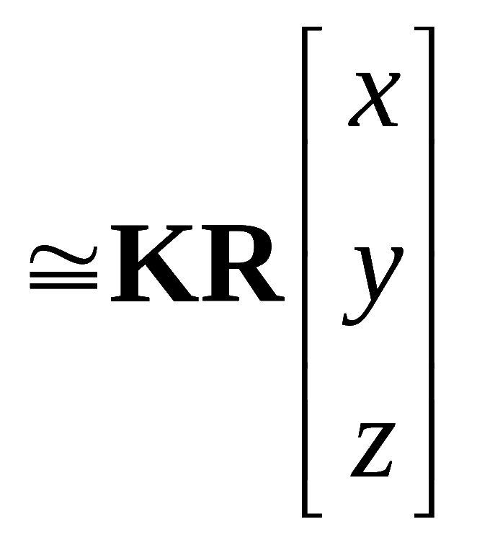
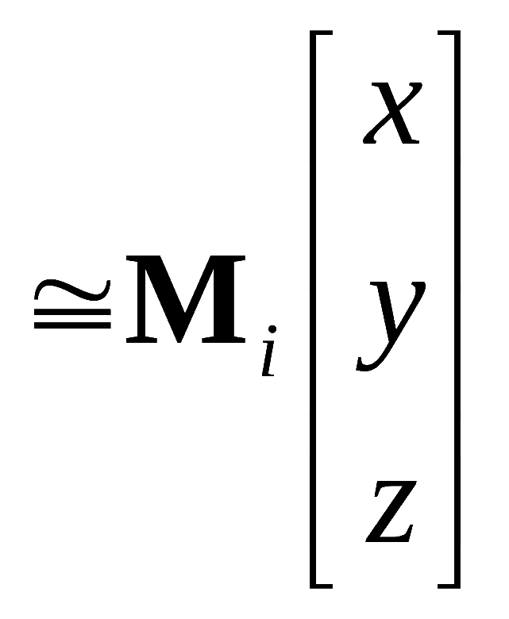

Self-Calibrating Rotating Cameras
Last column of the camera is always ZERO; the 4th coordinates is immaterial.
is a mapping b/w 2D projective object space (x y z) and 2D projective image space (u v w).

Slide 14


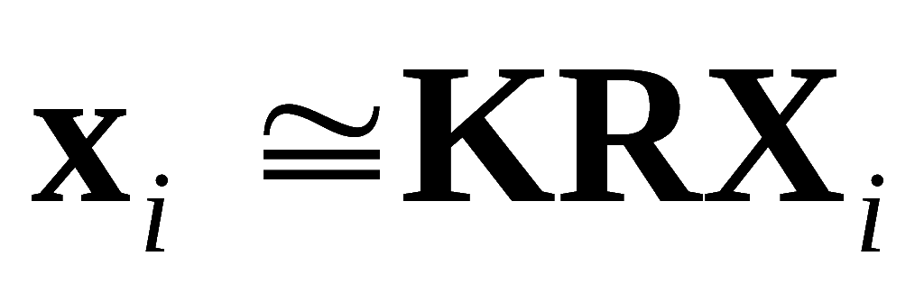
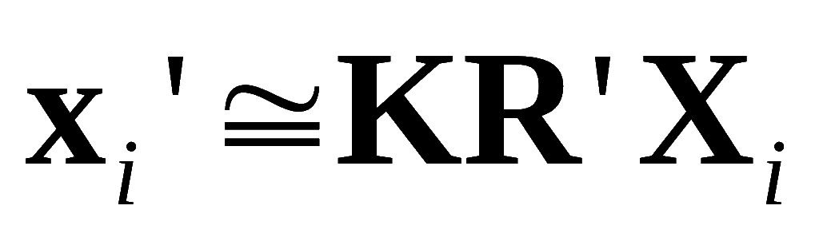
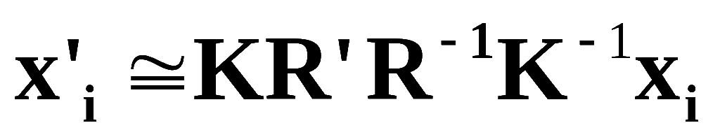
Self-Calibrating Rotating Cameras
H is conjugate of rotation R

Slide 15
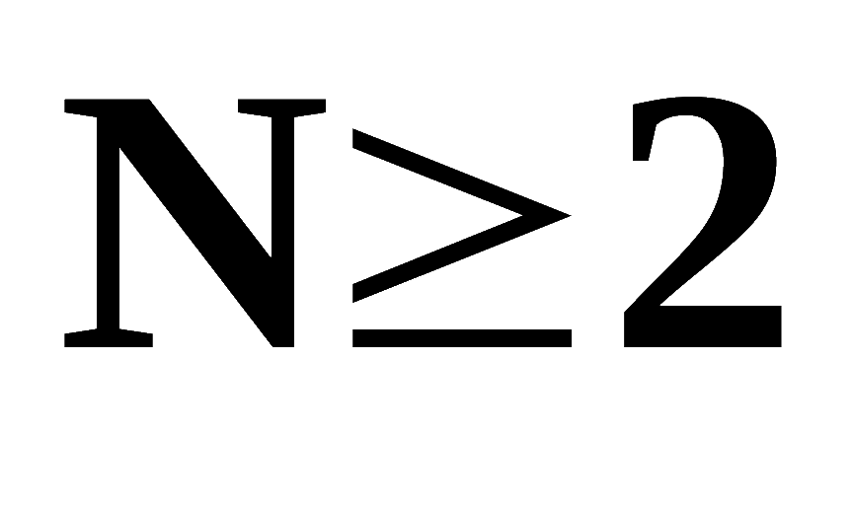



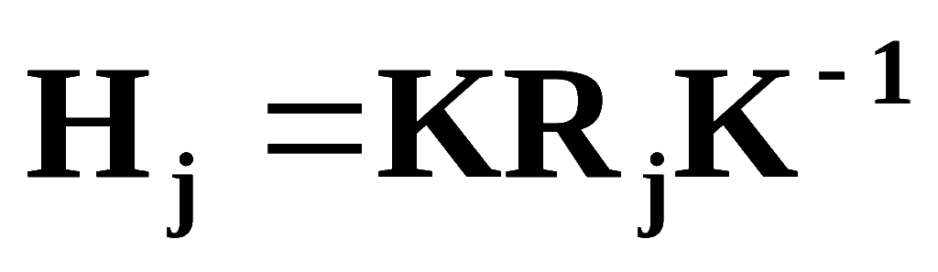
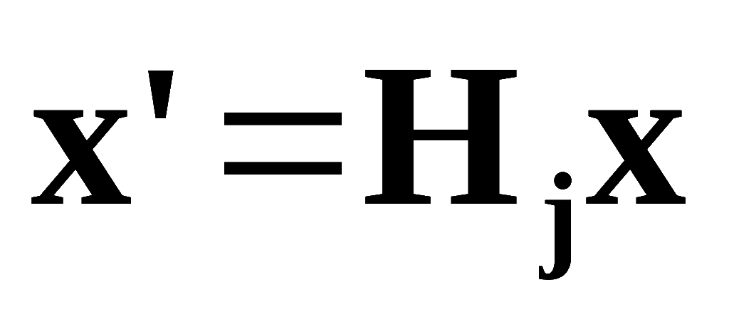
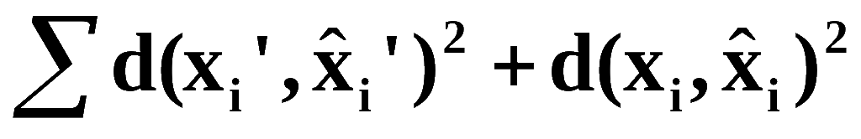
Self-Calibrating Rotating Cameras
Given a set of images:
there exists a transformation that takes image to image :

Slide 16
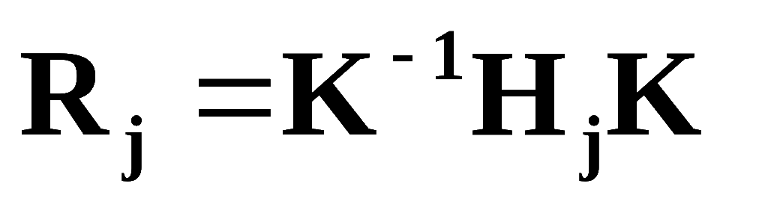
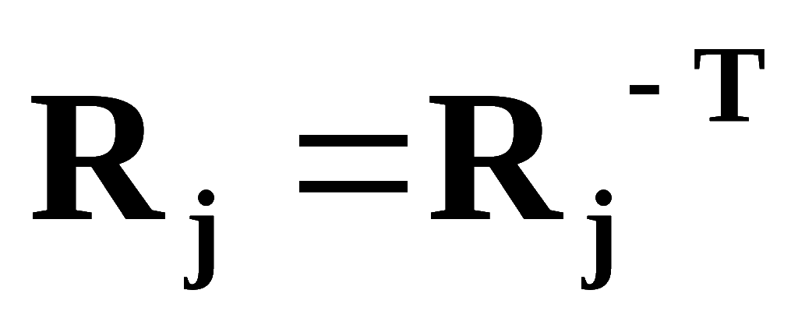
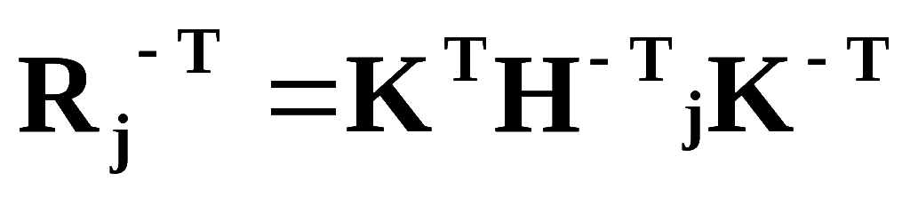
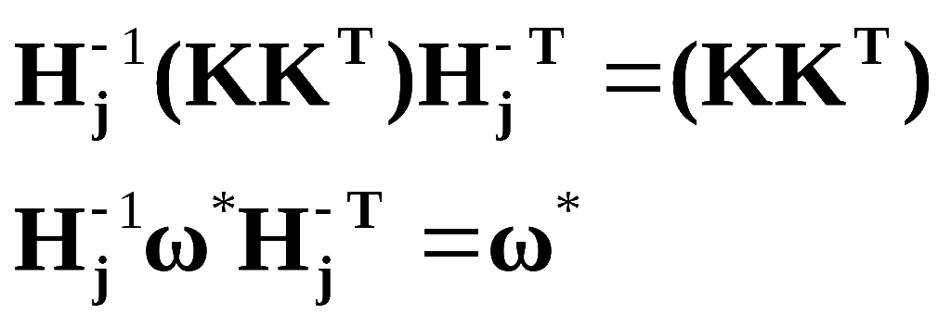

Self-Calibrating Rotating Cameras
To estimate K:

Slide 17


Self-Calibrating Rotating Cameras
Denote
9 linear equations with six different entries
If more than two images are available, an overconstrained system of equations may be written:
Solution is the eigen vector corresponding to the lowest eigenvalue.

Slide 18





Self-Calibrating Rotating Cameras
Obtain K by Choleski factroization:
C should be positive-definite:
by SVD:
In order to make V upper triangular, perform QR decomposition on V: KR
Iteratively refine K

Slide 19



Slide 20
Self-Calibration of Rotating and Zooming Cameras
L. Agapito, E. Hayman, I. Reid.
International Journal of Computer Vision(IJCV)
45, pp. 107-127. 2001

Slide 21









Self-Calibration of Rotating and Zooming Cameras [Agapito et al].
condition
constraint
type
#constraints
Zero skew
quadratic
m
Principal point
linear
2m
Zero skew (& p.p.)
linear
m
Fixed aspect ratio (& p.p.& Skew)
quadratic
m-1
Known aspect ratio (& p.p.& Skew)
linear
m
Focal length
(& p.p. & Skew)
linear
m

Slide 22






Self-Calibration of Rotating and Zooming Cameras [Agapito et al].
Inverting both sides:
use constraints on camera intrinsics:
  Zero skew
  Zero skew and unit aspect ratio:
  Zero skew and zero Uo:
  Zero skew and zero Vo:

Slide 23
Self-Calibration of Rotating and Zooming Cameras [Agapito et al].
Each constraint provides one equation on the entries of IAC.
If more than 5 equations are available, we can obtain a least squares solution.
Use the result as the initial estimate for a non-linear method.

Slide 24



Self-Calibration of Rotating and Zooming Cameras [Agapito et al].
Nonlinear:
Counting Argument:
Minimal Assumption: at least one of the parameter must be constant throughout the sequence
Use Levenberg-Marquardt to minimize

Slide 25



Self-Calibration of Rotating and Zooming Cameras [Agapito et al].
Maximum Likelihood Estimation:
Using prior knowledge:

Slide 26
Self-Calibration of Rotating and Zooming Cameras [Agapito et al].
Algorithm:
  Compute inter-image homographies
  Use linear-algorithm for initial estimates of K and R
  Use these as initial estimates for non-linear method.
  Refine these parameters using the MLE minimization.

